Slide 1

Data and Workflow Management with the signac Framework
Vyas Ramasubramani, Carl S. Adorf, Bradley D. Dice, Sharon C. Glotzer

Slide 2
Planning a Parameter Study
concentration_A_0.25/
concentration_A_0.50/
concentration_A_0.75/
Notes:
Points to state:
How do you select data? How do you search? How do you subset?
How do you automate the workflow? Do you just run each step manually? How do you avoid human error in the sequence?
How do you modify script generation? How do you switch between schedulers?

Slide 3
Planning a Parameter Study
concentration_A/0.25
concentration_A/0.50
concentration_A/0.75
Notes:
Points to state:
How do you select data? How do you search? How do you subset?
How do you automate the workflow? Do you just run each step manually? How do you avoid human error in the sequence?
How do you modify script generation? How do you switch between schedulers?

Slide 4
Planning a Parameter Study
conc_A/0.25
conc_A/0.50
conc_A/0.75
Notes:
Points to state:
How do you select data? How do you search? How do you subset?
How do you automate the workflow? Do you just run each step manually? How do you avoid human error in the sequence?
How do you modify script generation? How do you switch between schedulers?

Slide 5
Planning a Parameter Study
conc_A/0.25/temp_08
conc_A/0.25/temp_1
conc_A/0.50
conc_A/0.75
Notes:
Points to state:
How do you select data? How do you search? How do you subset?
How do you automate the workflow? Do you just run each step manually? How do you avoid human error in the sequence?
How do you modify script generation? How do you switch between schedulers?

Slide 6
Planning a Parameter Study
temp_08/conc_A/0.25
temp_08/conc_A/0.50
temp_08/conc_A/0.75
temp_1/conc_A/0.25
Notes:
Points to state:
How do you select data? How do you search? How do you subset?
How do you automate the workflow? Do you just run each step manually? How do you avoid human error in the sequence?
How do you modify script generation? How do you switch between schedulers?

Slide 7
Planning a Parameter Study
temp_08/conc_A/25/conc_B/05
temp_08/conc_A/50
temp_08/conc_A/75
temp_1/conc_A/25
Notes:
Points to state:
How do you select data? How do you search? How do you subset?
How do you automate the workflow? Do you just run each step manually? How do you avoid human error in the sequence?
How do you modify script generation? How do you switch between schedulers?

Slide 8
Planning a Parameter Study
Notes:
Points to state:
How do you select data? How do you search? How do you subset?
How do you automate the workflow? Do you just run each step manually? How do you avoid human error in the sequence?
How do you modify script generation? How do you switch between schedulers?

Slide 9

The signac Framework
A lightweight, application-agnostic software framework that unobtrusively helps users manage and scale file-based workflows, facilitating data reuse, sharing, and reproducibility.
Python 2/3 | open source BSD-3 | install with pip or conda
www.signac.io
Simple data and workflow management with the signac framework, JCMS 146, 220-229, (2018)

Slide 10



signac integrates easily within your software stack
signac is meant to be used as part of any software stack involving simulations, analysis, machine learning, visualization, etc.
It is most effective where users need a database, but do not want to deal with the overhead of migrating files to and from a network database.
Glotzer group software stack

Slide 11
Data (signac) and Workflow (signac-flow) Management
signac
signac-flow
signac: A Python framework for data and workflow management. In Proceedings of the 17th Python in Science Conference, 2018.
Notes:
This is an overview of how signac manages data (left) and signac-flow manages workflows (right).
The workspace consists of individual data containers, called jobs, where each job is associated with a distinct metadata mapping (state point).
The workflow consists of operations that are linked through condition functions. The operations and conditions form a directed graph.

Slide 12
Data (signac) and Workflow (signac-flow) Management
signac
signac-flow
The workspace consists of jobs, data containers associated with distinct metadata mappings (called state points).
signac: A Python framework for data and workflow management. In Proceedings of the 17th Python in Science Conference, 2018.
Notes:
This is an overview of how signac manages data (left) and signac-flow manages workflows (right).
The workspace consists of individual data containers, called jobs, where each job is associated with a distinct metadata mapping (state point).
The workflow consists of operations that are linked through condition functions. The operations and conditions form a directed graph.

Slide 13
Data (signac) and Workflow (signac-flow) Management
signac
signac-flow
The workspace consists of jobs, data containers associated with distinct metadata mappings (called state points).
signac: A Python framework for data and workflow management. In Proceedings of the 17th Python in Science Conference, 2018.
Notes:
This is an overview of how signac manages data (left) and signac-flow manages workflows (right).
The workspace consists of individual data containers, called jobs, where each job is associated with a distinct metadata mapping (state point).
The workflow consists of operations that are linked through condition functions. The operations and conditions form a directed graph.

Slide 14
Data (signac) and Workflow (signac-flow) Management
signac
signac-flow
The workspace consists of jobs, data containers associated with distinct metadata mappings (called state points).
The workflow consists of operations, linked through condition functions. This forms a directed graph.
signac: A Python framework for data and workflow management. In Proceedings of the 17th Python in Science Conference, 2018.
Notes:
This is an overview of how signac manages data (left) and signac-flow manages workflows (right).
The workspace consists of individual data containers, called jobs, where each job is associated with a distinct metadata mapping (state point).
The workflow consists of operations that are linked through condition functions. The operations and conditions form a directed graph.

Slide 15


Top 6 Features Released In Last 12 Months
Import/export of data
Schema Detection
Synchronization
'T': int([298, 300, 302])
'P': float([0.1, 1.0])
Improved Container Support
Templating
One-script Projects
Implement workflows in < 10 lines.
jinja2
container by DPIcons from the Noun Project
Relational Schema by Becris from the Noun Project
search data by SBTS from the Noun Project
Workflow by ProSymbols from the Noun Project

Slide 16
Working with Jobs and Projects
Modify state point: job.sp.P = 5
Lightweight storage: job.doc['count'] = 10
Selection: project.find_jobs({'T': 298})
Group: for a, g in project.groupby('T'):

Slide 17
Working with FlowProjects
from flow import FlowProject
class MyProject(FlowProject):
pass
@MyProject.operation
@MyProject.post.true('finished')
def compute(job):
job.doc.finished = True

Slide 18
LIVE DEMO

Slide 19
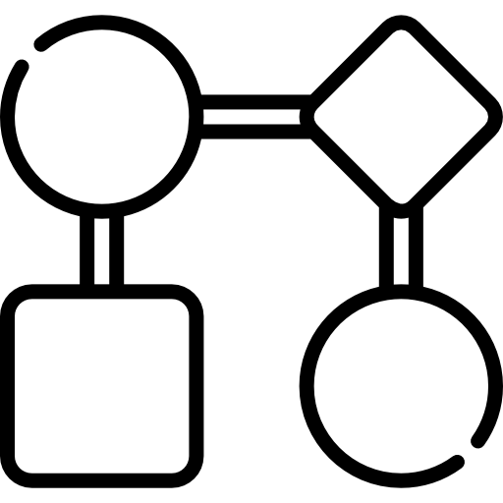
Latest Development
Better handling of dynamically growing data spaces for improved support of optimization workflows.
write_log()
Cross-project links
snapshot()
for complex data spaces.
git commit
signac://…
An operations log can be used to generate a graph of actions.
Execution hooks allow consistent tracking of all operations that manipulate the data space.
Easily store data in HDF5 files
job.data[rand] = np.random.rand(int(1e8))
Icons made by Smashicons and Freepik from www.flaticon.com are licensed by CC BY3.0. Image from https://www.neonscience.org/about-hdf5
Notes:
Sources:
<div>Icons made by <a href="http://www.freepik.com" title="Freepik">Freepik</a> from <a href="https://www.flaticon.com/" title="Flaticon">www.flaticon.com</a> is licensed by <a href="http://creativecommons.org/licenses/by/3.0/" title="Creative Commons BY 3.0" target="_blank">CC 3.0 BY</a></div>
<div>Icons made by <a href="https://www.flaticon.com/authors/smashicons" title="Smashicons">Smashicons</a> from <a href="https://www.flaticon.com/" title="Flaticon">www.flaticon.com</a> is licensed by <a href="http://creativecommons.org/licenses/by/3.0/" title="Creative Commons BY 3.0" target="_blank">CC 3.0 BY</a></div>

Slide 20
Automated Machine Learning Workflows
From dynamic workflows...
... to distributed, iterative exploration
signac data spaces are suited for complex optimization tasks
signac-flow adds new jobs from previously learned data
prioritized exploration in high dimensional spaces
distribution across systems
Relational Schema by Becris from the Noun Project

Slide 21
The Future: signac 2.0
Allow iteration over arbitrary folder indexes
Optimize for flat project workspaces
Unify approach for signac projects and less structured directories

Slide 22
Impact of signac
In use by several research groups across the country, especially in materials science and molecular simulations
Princeton, Vanderbilt, Boise State, Air Force Research Laboratory, ...
30,000+ downloads of signac & signac-flow conda packages
Actively used on projects with thousands of jobs and terabytes of data
signac-flow has built-in support for XSEDE and INCITE clusters, and adaptable templates for any SLURM/TORQUE/LSF scheduler

Slide 23

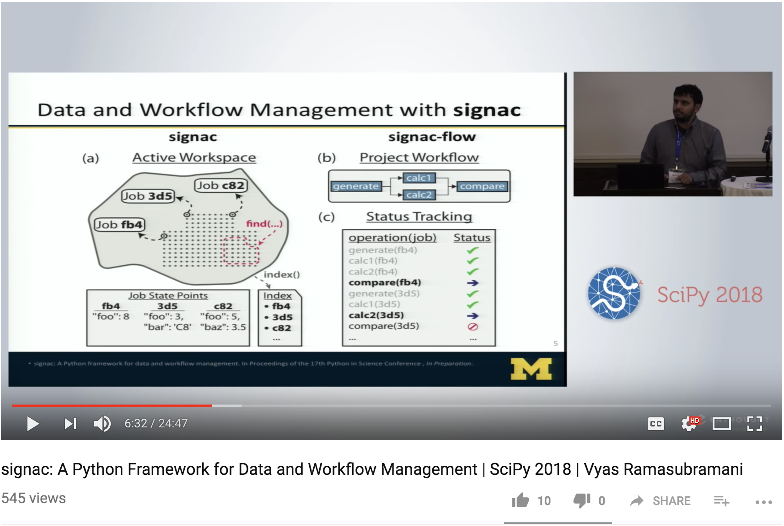



Community Building
721 views

Slide 24
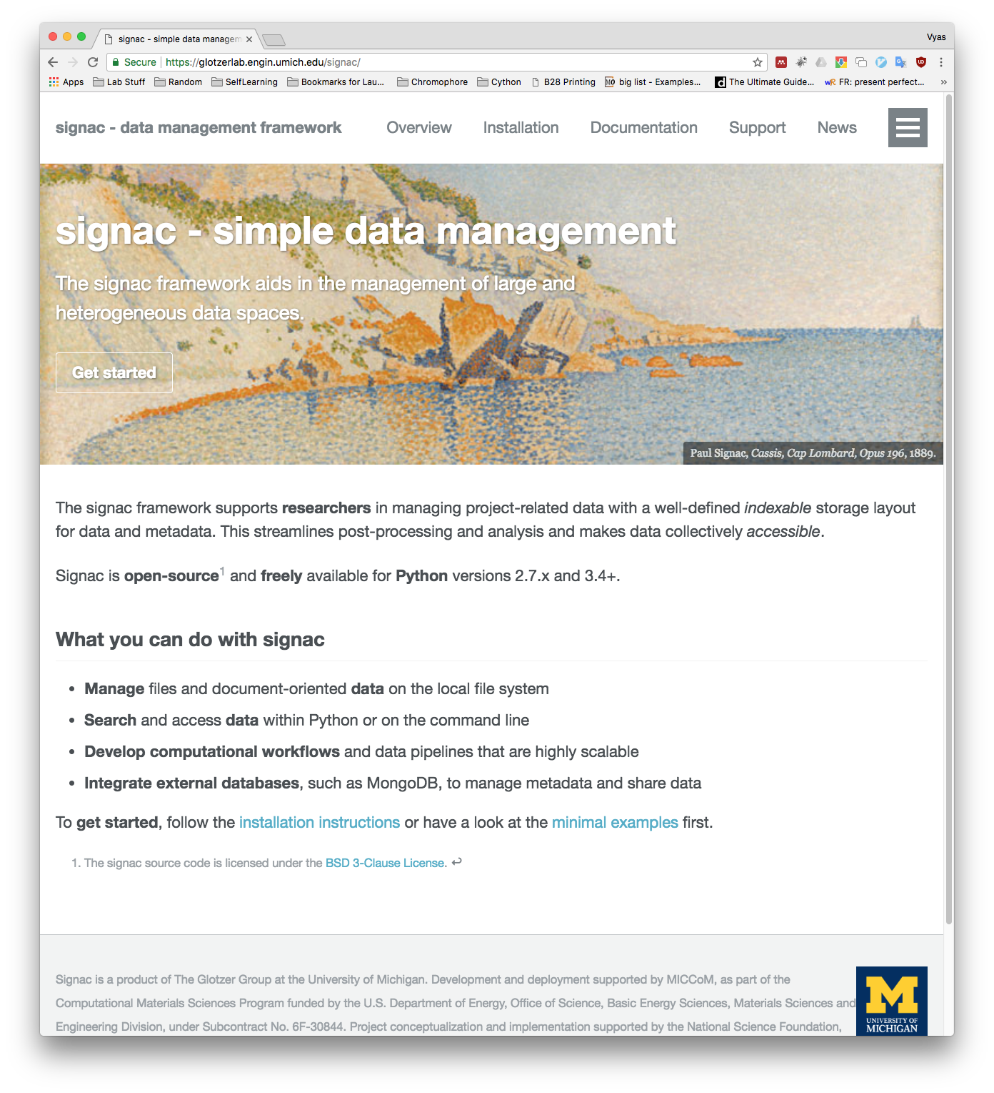
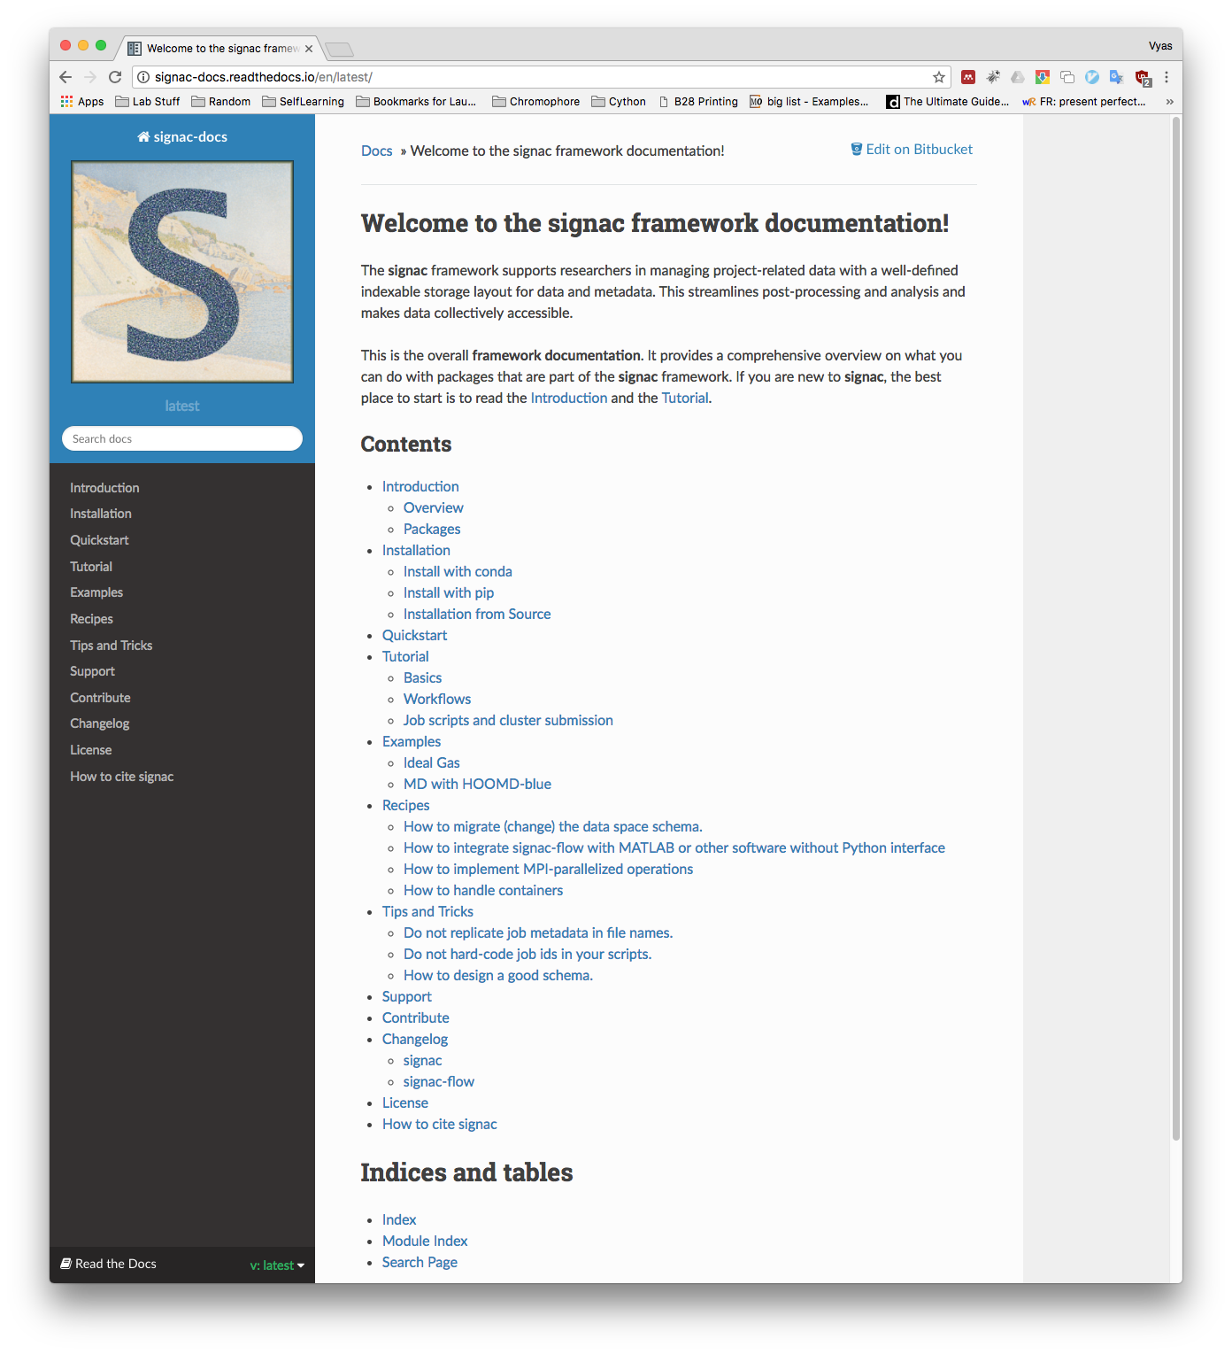
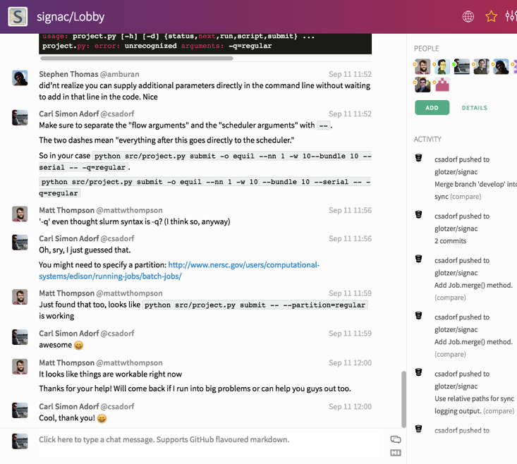
News, Documentation & Chat Room Support
www.signac.io
docs.signac.io
https://gitter.im/signac/Lobby
Notes:
The website is the primary gateway for new users to learn about the project, read news, and find support resources.
The signac-docs website is the primary technical support resource.

Slide 25


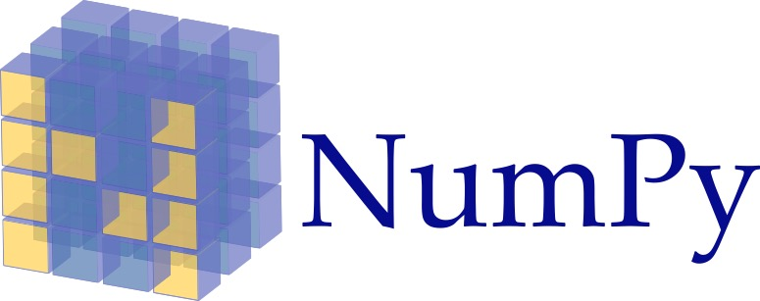
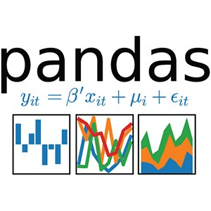

Sustainability: Anchor within the Scientific Python Ecosystem
https://numfocus.org/
https://commons.wikimedia.org/wiki/File:NumPy_logo.svg
https://www.fullstackpython.com/scipy-numpy.html
http://www.howcsharp.com/147/pandas.html

Slide 26
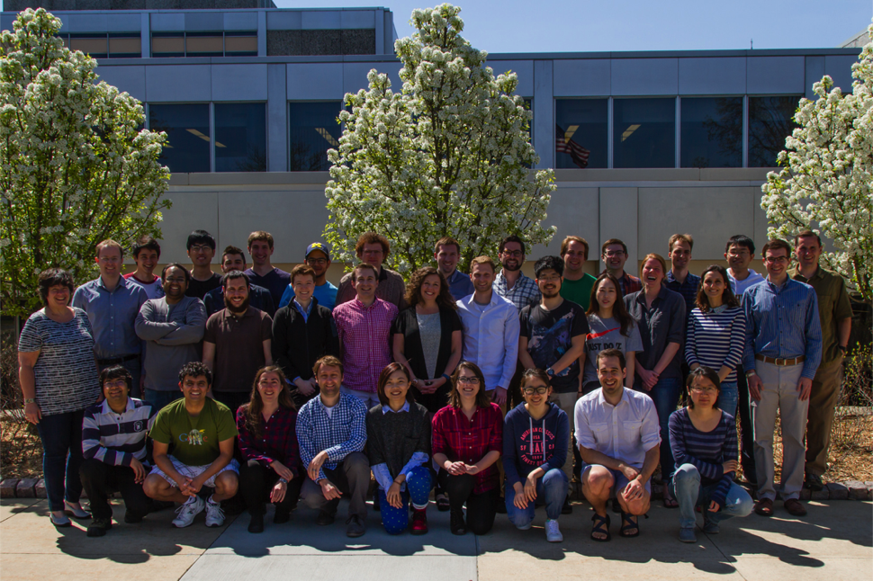

Thank you!
signac is a product of the Glotzer Group at the University of Michigan. Development and deployment supported by UM and MICCoM, as part of the Computational Materials Sciences Program funded by the U.S. Department of Energy, Office of Science, Basic Energy Sciences, Materials Sciences and Engineering Division, under Subcontract No. 6F-30844. Project conceptualization and early implementation supported by the National Science Foundation, Award # DMR 1409620.
www.signac.io

